Slide 1

Central Dogma of Molecular Biology
“The central dogma of molecular biology deals with the detailed residue-by-residue transfer of sequential information. It states that such information cannot be transferred back from protein to either protein or nucleic acid.”
Francis Crick, 1958

Slide 2
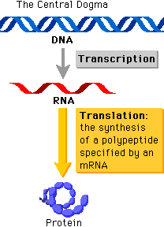
… in other words
Protein information cannot flow back to nucleic acids
Fundamental framework to understanding the transfer of sequence information between biopolymers

Slide 3
Presentation Outline
PART I
  The Basics
  DNA Replication
  Transcription
PART II
  Translation
  Protein Trafficking & Cell-cell communications
  Conclusion

Slide 4
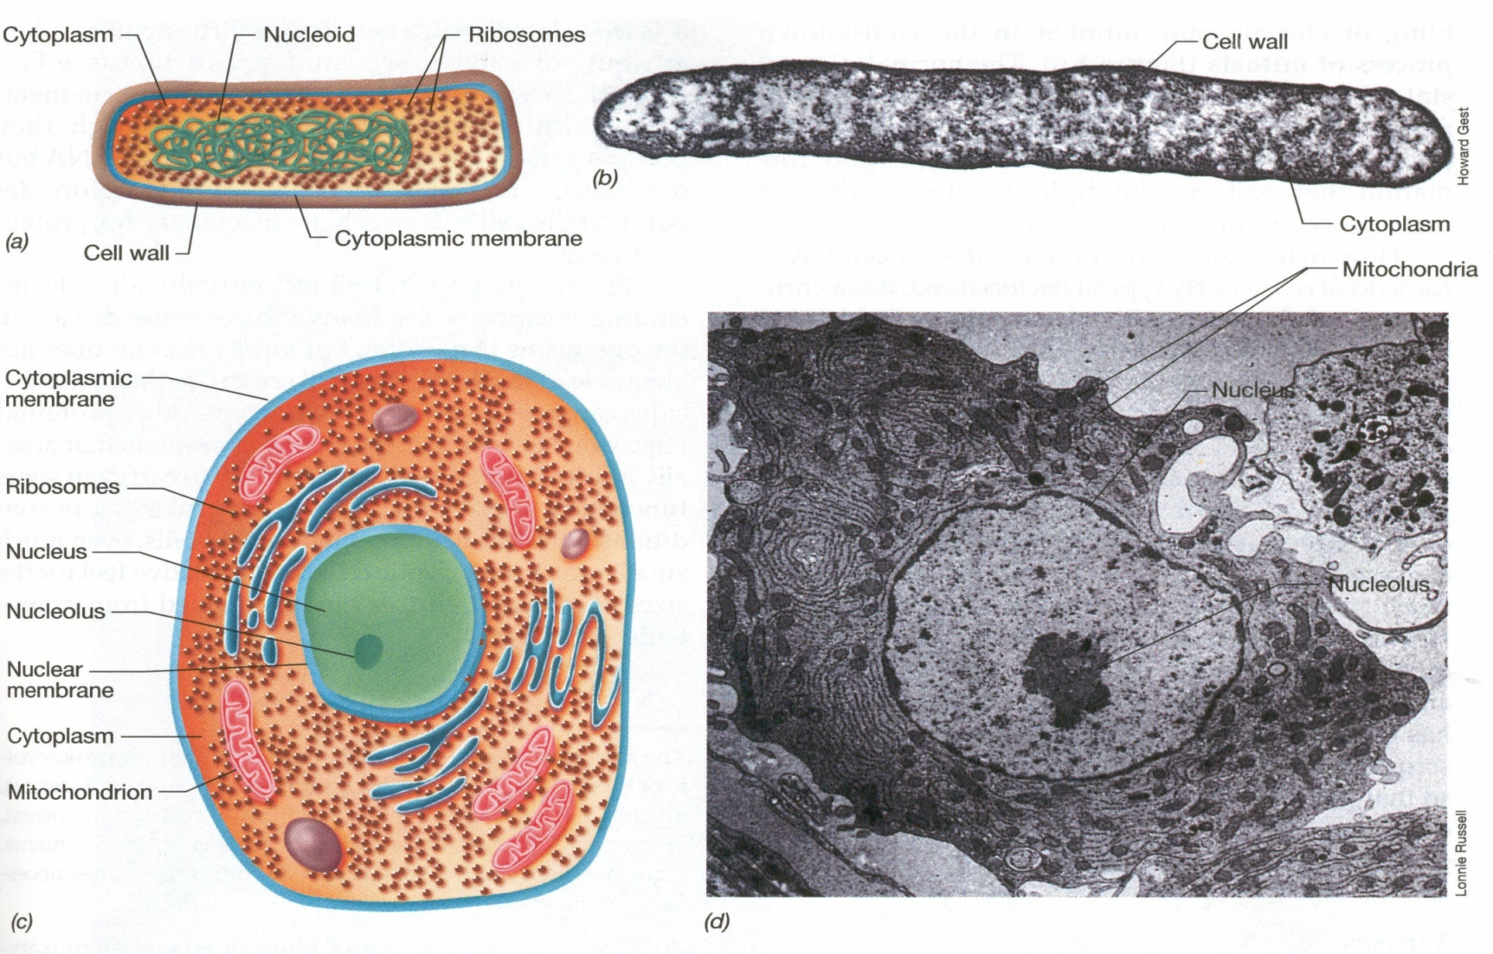
The Basics: Cell Organization
  Prokaryotes
  Eukaryotes

Slide 5
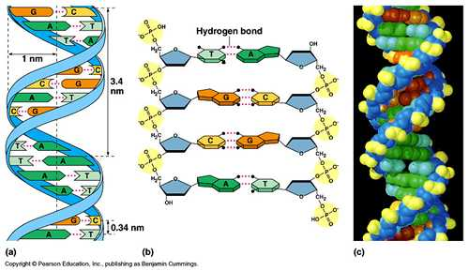
The Basics: Structure of DNA

Slide 6
The Basics: Additional Points
DNA => A T C G, RNA => A U C G
Almost always read in 5' and 3' direction
DNA and RNA are dynamic - 2° structure
Not all DNA is found in chromosomes
  Mitochondria
  Chloroplasts
  Plasmids
  BACs and YACs
Some extrachromosomal DNA can be useful in Synthetic Biology

Slide 7
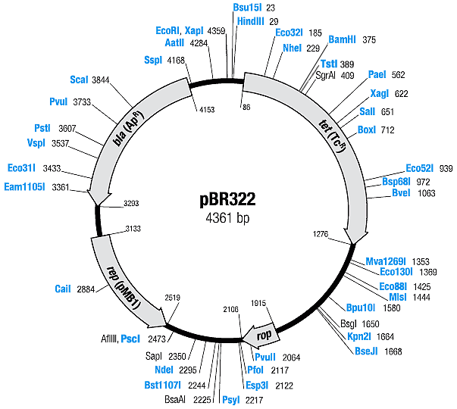
… an example of a plasmid vector
Gene of interest
Selective markers
Origin of replication
Restriction sites

Slide 8
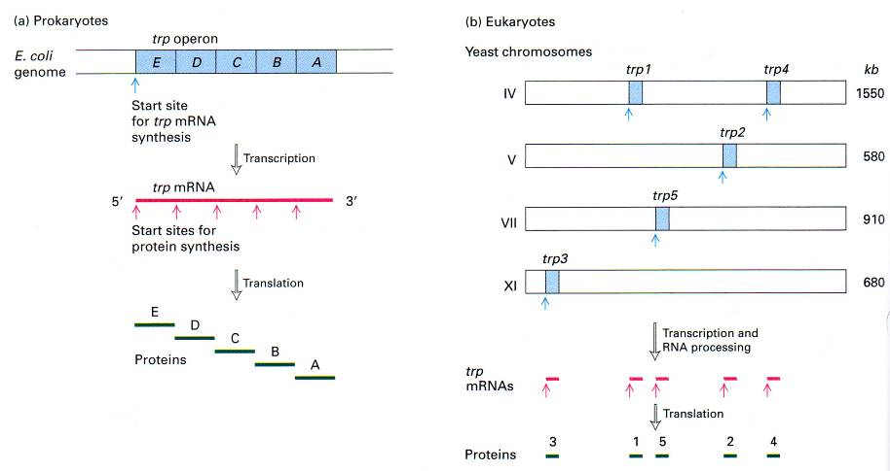
The Basics: Gene Organization
… now to the main course

Slide 9
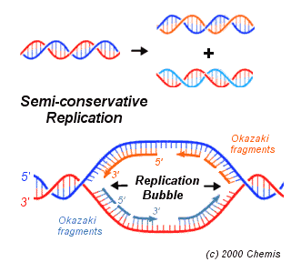
DNA Replication
The process of copying double-stranded DNA molecules
Semi-conservative replication
  Origin of replication
  Replication Fork
Proofreading mechanisms

Slide 10
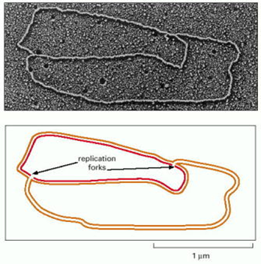
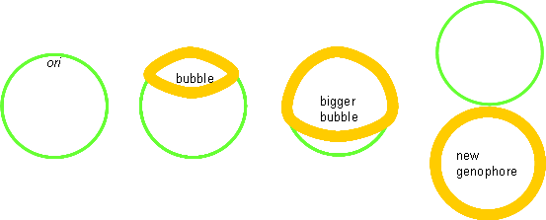
DNA Replication: Prokaryotic origin of replication
1 origin of replication; 2 replication forks

Slide 11
DNA Replication: Enzymes involved
Initiator proteins (DNApol clamp loader)
Helicases
SSBPs (single-stranded binding proteins)
Topoisomerase I & II
DNApol I – repair
DNApol II – cleans up Okazaki fragments
DNApol III – main polymerase
DNA primase
DNA ligase

Slide 12
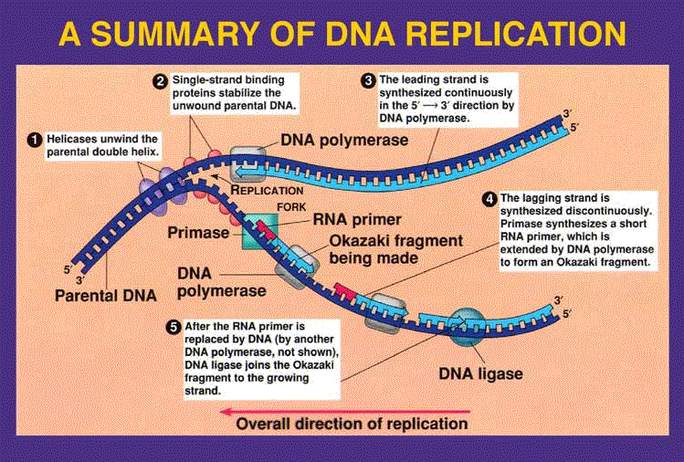
DNA Replication:

Slide 13
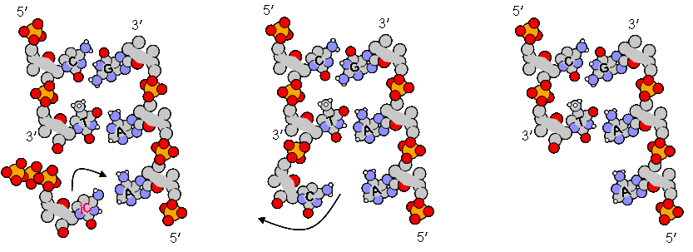
DNA Replication: Proofreading mechanisms
DNA is synthesised from dNTPs. Hydrolysis of (two) phosphate bonds in dNTP drives this reduction in entropy.
- Nucleotide binding error rate =>c.10⁻⁴, due to extremely short-lived imino and enol tautomery.
- Lesion rate in DNA => 10⁻⁹.
Due to the fact that DNApol has built-in 3’ →5’ exonuclease activity, can chew back mismatched pairs to a clean 3’end.

Slide 14
Transcription
Process of copying DNA to RNA
Differs from DNA synthesis in that only one strand of DNA, the template strand, is used to make mRNA
Does not need a primer to start
Can involve multiple RNA polymerases
Divided into 3 stages
  Initiation
  Elongation
  Termination

Slide 15
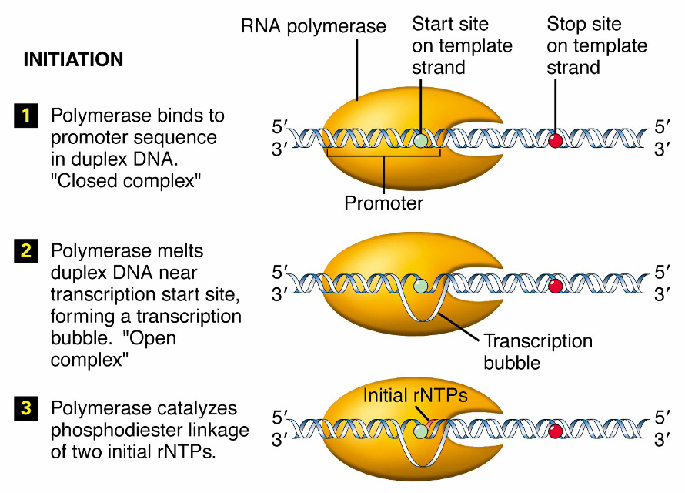

Slide 16
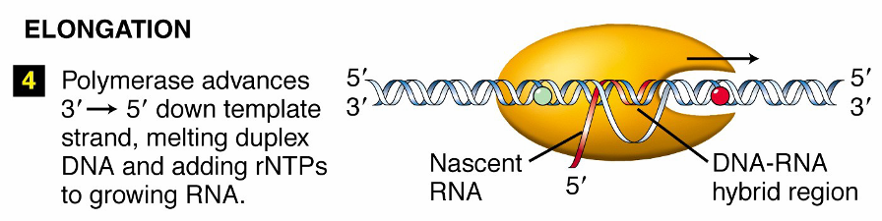

Slide 17
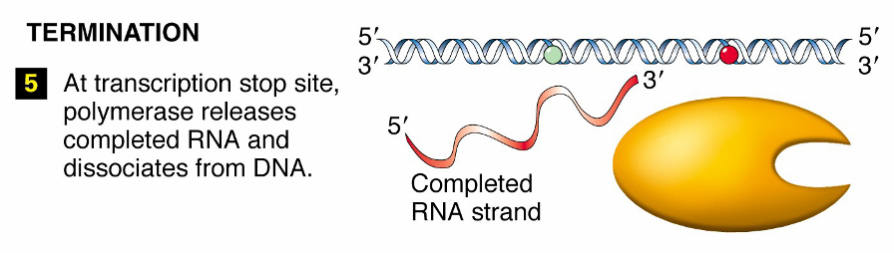

Slide 18
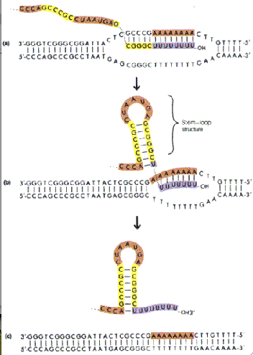
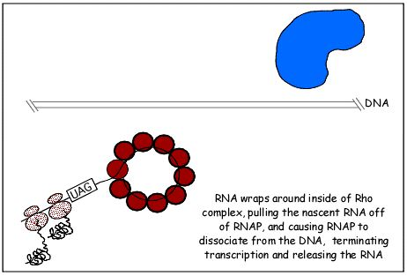

Slide 19
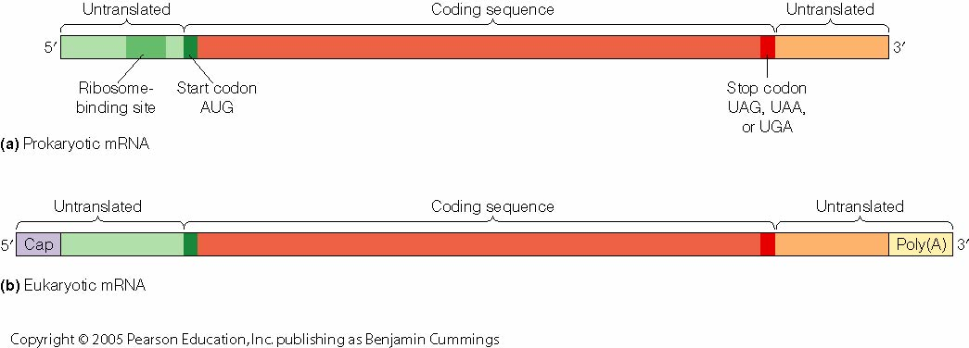
Transcription: The final product

Slide 20
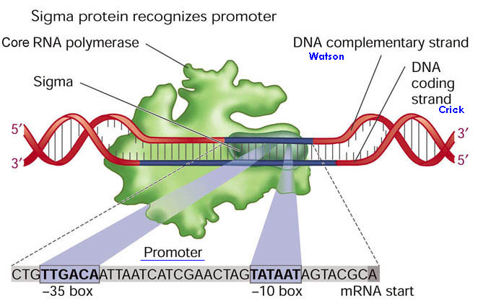
Transcription: Transcriptional control
Different promoters for different sigma factors

Slide 21
… Case study – Lac operon
For control of lactose metabolism
Consists of three structural genes, a promoter, a terminator and an operator
LacZ codes for a lactose cleavage enzyme
LacY codes for ß-galactosidase permease
LacA codes for thiogalactoside transcyclase
When lactose is unavailable as a carbon source, the lac operon is not transcribed

Slide 22
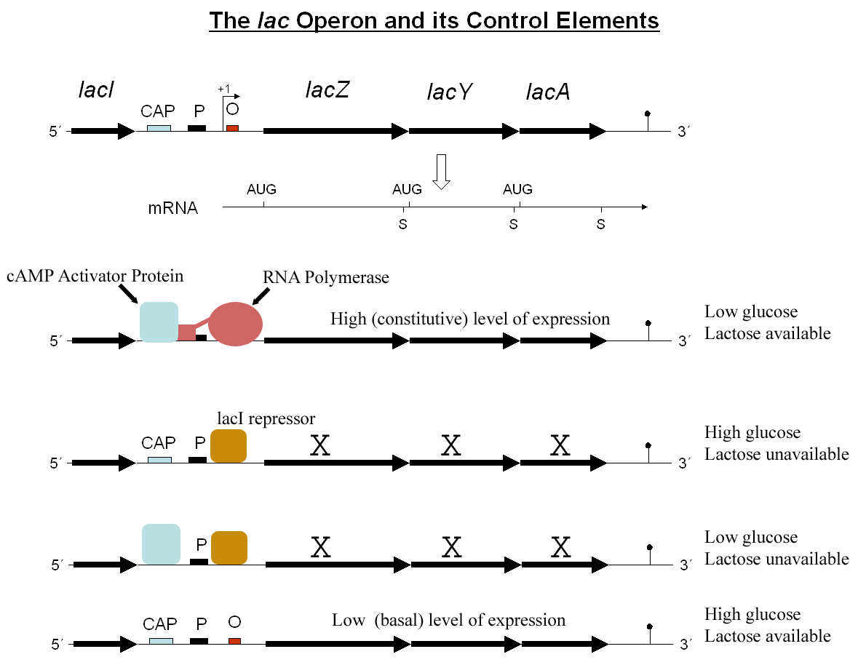

Slide 23
The regulatory response requires the lactose repressor
The lacI gene encoding repressor lies nearby the lac operon and it is consitutively (i.e. always) expressed
In the absence of lactose, the repressor binds very tightly to a short DNA sequence just downstream of the promoter near the beginning of lacZ called the lac operator
Repressor bound to the operator interferes with binding of RNAP to the promoter, and therefore mRNA encoding LacZ and LacY is only made at very low levels
In the presence of lactose, a lactose metabolite called allolactose binds to the repressor, causing a change in its shape
The repressor is unable to bind to the operator, allowing RNAP to transcribe the lac genes and thereby leading to high levels of the encoded proteins.

